Slide 1
Business Systems:
Unleashing Organizational Systems for Success
Presented to Bruce County Economic Development
January 30, 2024

Slide 2
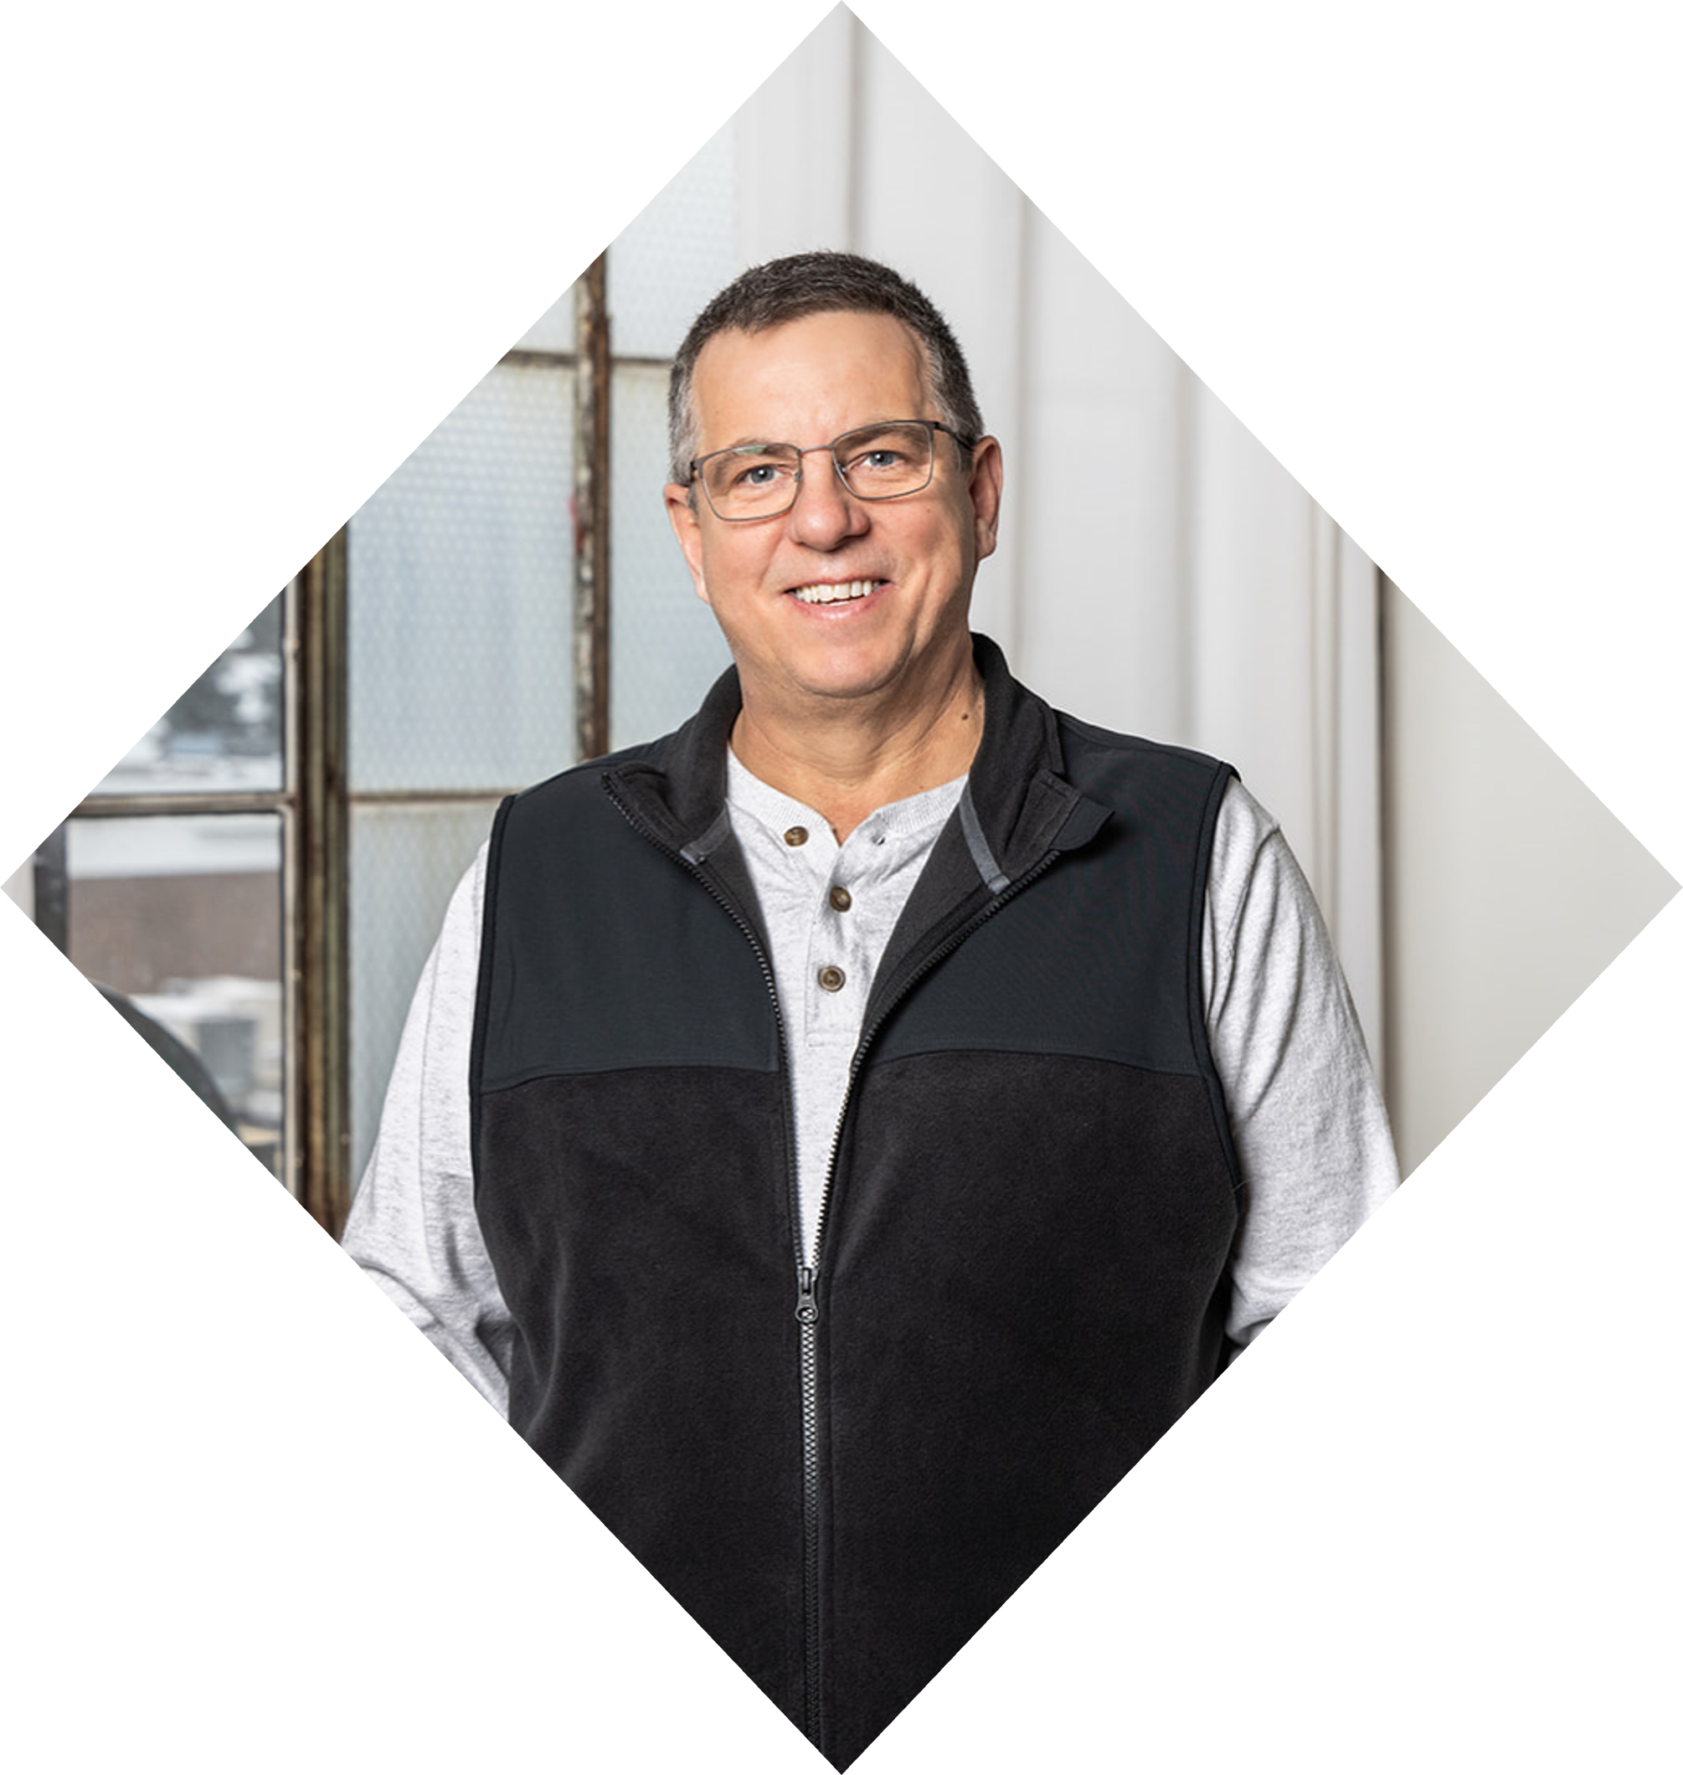
60 years old Serial Entrepreneur
PAUL OEHM
Started, built and sold five companies in the past 40 years

Slide 3
Paul’s Companies & History
Since 1983 Paul has started, scaled and sold five companies in five completely different industries!
Plus, number six is current business – Business Profit
Over & $120 M in Sales
1
2
3
4
5
6
9x Years
23x Years
13x Years
11x Years
4x Years
2019-
To date
4x Years
1983-1992
1990-2013
1991-2004
2000-2011
2015-2019
Agri Business – Feed, Grains and Farm Supplies Business
Road
Construction Business
Filtration & Parts Business. Heavy Eqpt & Industrial parts distribution business
Hot Tub, Pool and Backyard Living Products, Purified Water
E-Comm -
Shopify
Store
Business Profit Business Advisory Services
SOLD
SOLD
SOLD
SOLD
SOLD
PRESENT

Slide 4
Business Profit
Turning Potential into Profit
Focusing on Systems, Efficiencies & Profits!

Slide 5
Goal
Give you the tools to operate and grow a successful, profitable, systemized business
Help you understand the bottlenecks & opportunities within your business
Help you get a clear vision for the future of your business

Slide 6
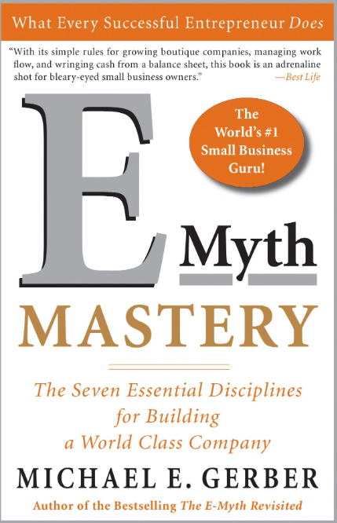
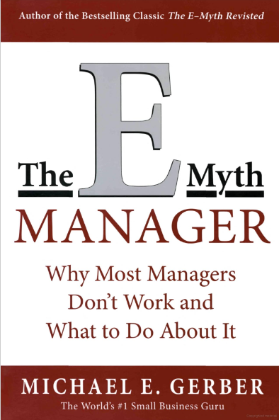
I dedicate this workshop to Michael Gerber
& E-Myth Books

Slide 7
What is a Business System?
Definition
A Structure and interconnected set of processes, procedures, and components designed to achieve specific business objectives or functions within a business.

Slide 8
What is a Business System?
Simple Terms/ Definition
“A Recipe” Step by step proven process to get stuff done
*SOP

Slide 9
An example of one of the best Systemized Companies

Slide 10
45% of Canadian small business owners want to sell or retire in the next 10 years. Are they sale-ready?

Slide 11
Is your business sale-ready for maximum multiple of FCF or EBITDA?

Slide 12
Only Four Ways to Get Out of Business
Death
Bankrupt or Close down
Sell Assets – Pennies on the dollar
Sell Business for a multiple of FCF (Free Cash Flow) or EBITDA (earnings before interest, taxes, depreciation and amortization)

Slide 13
Systemization allows you to:
Working ON your Business Vs Working IN your Business

Slide 14
The Curse of the Entrepreneur
Entrepreneurs are typically very good at what they do but may not excel in certain business functions
Accounting
HR
Marketing & Sales
Legal
Networking
Customer Service
Entrepreneur
Seizure

Slide 15
Are you running your business OR Is your business running you?
Are you an employee in your own business?

Slide 16
Why do People buy Franchises for 10s or 100’s of thousands of dollars?
Recipe > Repeatable, predictable results that anyone can be taught!

Slide 17
As a Business Owner, Ask yourself these questions:
Sales staff – Deal/ Quote Pipeline
Amount of work in quoting process
Amount of orders/ work ahead of you
Customer service issues
If work assigned to employees is getting done and at what stage it is at?
Del, Install, Service Work, Production - Schedules - Stage of completion
Employee schedules and time worked
Maintenance schedules
Asset lists and details
Do you have full visibility on your phone or computer of what is happening in real time in all areas of your business?
Workflow Examples:

Slide 18
As a Business Owner, Ask yourself these questions:
CRM – Customer Relations Management
History of contacts and details of emails and conversations, purchase history
Automatic reminders to re-contact with a client/ prospect or vendor.
A well managed CRM and Sales Process will give you keys to success

Slide 19
How are you Managing your Business Today?
Paper Books
Sticky Notes
Paper Checklists
Software Programs
Excel Files
Google Drive/Dropbox
Papered Work Orders
In between your Ears

Slide 20
Are you always switching computer programs, adding and looking for excel files, looking for that file – etc?

Slide 21
You are probably stressed and overwhelmed
Frustrated that you don’t know what is going on in all areas of your business
Don’t know what stage things are at i.e. Deliveries, Production or Service Crews
Is all work getting invoiced?
What if you are away from the business?

Slide 22
On top of all this, can you go on vacation and not worry about your business?

Slide 23
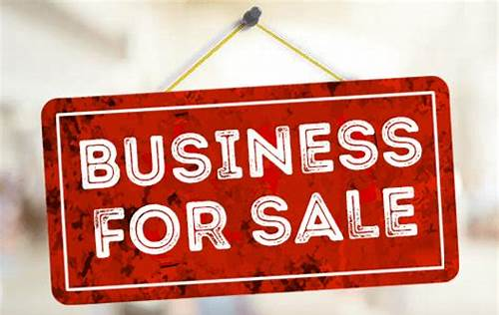
Who would buy this business if you wanted to sell it and for how much?

Slide 24
If you can relate to any of these issues or statements and you want to do better, SYSTEMS ARE YOUR ANSWER!

Slide 25
What are the Benefits of having a
Systemized Business?

Slide 26
Consistency: Standardized procedures ensure that the tasks are performed consistently, minimizing errors and improving of products and services.

Slide 27
Time Savings
Automation:
Systemization allows for the automation of repetitive tasks, freeing up time for business owners to focus on strategic decision making and growth initiatives.
Working ON the Business.

Slide 28
Faster Decision Making
With organized data and streamlined processes, business owners can make more informed decisions.

Slide 29
Scalability
Facilitates Growth
Systemized businesses are better equipped to handle growth and increased demand without sacrificing quality or efficiency.

Slide 30
Improve Employee Productivity
Clear Guidelines:
Employees benefit from well defined processes and procedures (SOPs) leading to increased productivity and job satisfaction.

Slide 31
Simplified Training
New employees can be on boarded more efficiently with clear guidelines and processes in place.

Slide 32
Reduced Dependence on Individuals
The departure of a key employee is less disruptive when processes and knowledge are documented and systemized!
Critical business knowledge is not dependent on individual employees, reducing the risk of knowledge loss

Slide 33
Enhanced Customer Satisfaction
Systemization ensures a consistent customer experience, leading to higher client satisfaction, a less customer turn over. (unhappy customers)
Improved processes allows for quicker response times to customer inquiries and issues.

Slide 34
Financial Benefits
Efficient operations and reduced errors contribute to cost savings and improving the overall financial health of the business
Systemization can lead to improved profit margins through better resource utilization and cost management

Slide 35
Preparation for Sale on Succession
A systemized business is more attractive to potential buyers, leading to a higher valuation
When a business is systemized, it becomes easier to transfer ownership or pass the business to the next generation with minimal disruption

Slide 36
Business Systemization is a Strategic investment that empowers business owners to run their operations more effectively, adapt to changing circumstances, and position their business for long term success.

Slide 37
What areas of your Business can you Systemize?

Slide 38
Empower Your Business with Tailored Systems

Slide 39
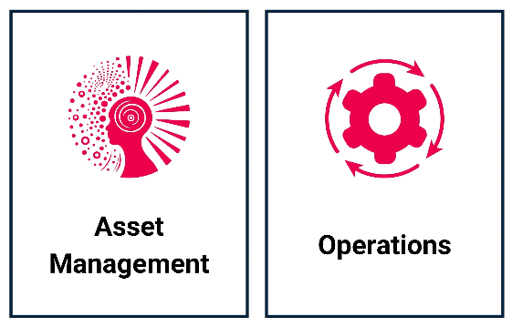
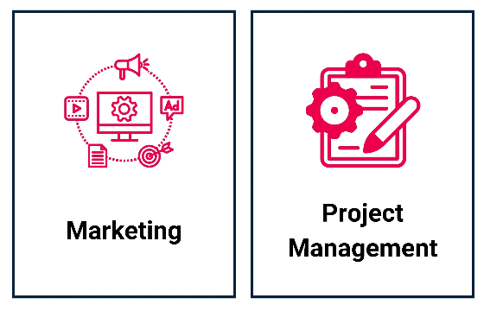
Business Workflows

Slide 40
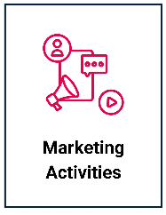
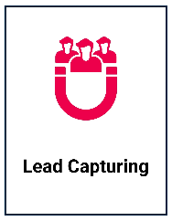
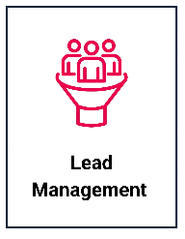
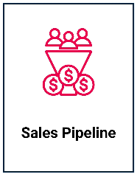
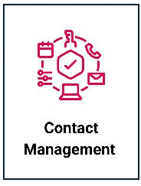
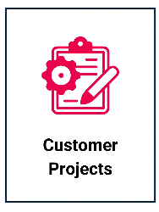
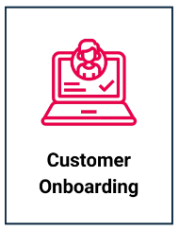
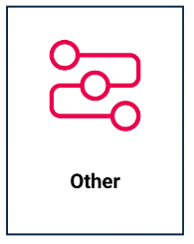
CRM/ Sales Management

Slide 41
How do you start the process of implementing Systems into your Business?

Slide 42
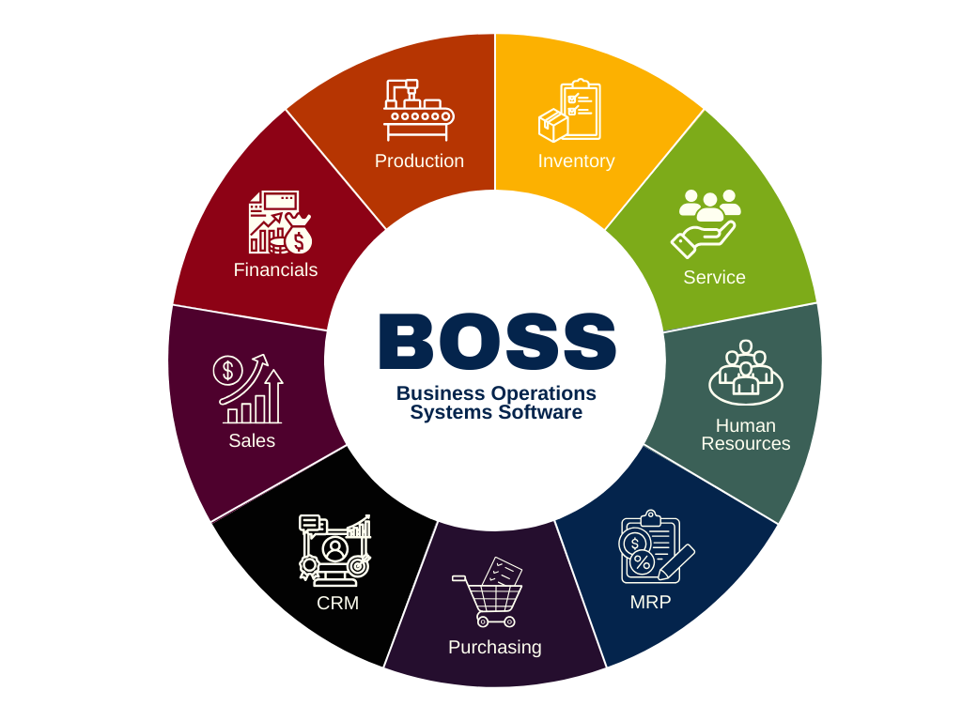
How do you start the process of implementing Systems into your Business?
Notes:
Duplicate Slide.

Slide 43
Assess and Plan
Sales
Marketing
Customer Service
Production
Installations & Repairs
Deliveries
HR
Financial
Etc.
List all critical processes within your business

Slide 44
Document Current Processes
Efficiencies to improve
Errors to improve
What is the outcome?
How will this help you scale?
Define Objectives

Slide 45
Document Current Processes
Involve employees who are directly involved in each process to provide feedback and insights of improvements
Document existing process step by step

Slide 46
Prioritize Processes
Priorities processes that have a significant impact on business operations, customer satisfaction, or profitability * What is your bottleneck?
Start with processes that are causing bottlenecks, errors on inefficiencies

Slide 47
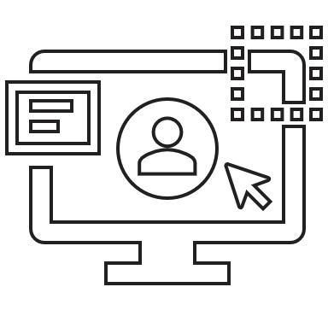
Select Appropriate Tools
Project Management Software
Use the right tools
BOSS
(Business Operations Systems Software)
CRM (customer relationship management) software

Slide 48
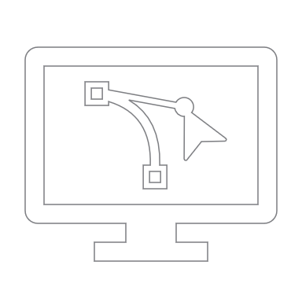
Select the Right Team
01
02
Do you have inhouse talent?
Look at outside consultants and experts
03
Does the software selected offer system creation or white gloves service

Slide 49
Staff Training
Provide training sessions for the staff
Clearly communicate how this will make their job easier and less stressful
Show them the benefits
Address any CONCERNS and questions

Slide 50
Monitor & Evaluate
Establish KPIs to measure the success
Conduct regular assessments to identify areas for improvements
Communicate with staff for feedback

Slide 51
Continuous Optimization
Continuously optimize processes and systems based on feedback, changing business needs and technological advancements

Slide 52
Scale Gradually
Once initial systems are successfully implemented, consider expanding systemization into other areas of the business
Ensure that your systems are designed to scale with the growth of your business

Slide 53
Summary
Implementing systems is ongoing
Business should adapt to the external environment and internal needs
Regularly reassess and refine your systems to keep aligned with your business objectives

Slide 54
Software of Choice
The software over 180,000 business Trust

Slide 55
Integrates with over 200 different softwares

Slide 56
Overall Benefits for Employees
People run the systems as the systems run the business
Happier employees that stick around
Less problems and errors to deal with
Reduced work loads
Less dependent on highly talented employees

Slide 57
Overall Benefits for Business Owners
Less turnover of employees
Happier customers that stay with you and buy more
More Customer referrals
Ahead of most competitors
Less issues & errors to deal with
Transparency across the complete business
Work ON Vs IN business

Slide 58
Overall Benefits for Business Owners
Improved profit and cash flow
Better work life balance
Improve home life
Able to get away from day to day grind
Take vacations & not worry
Have a business you can sell!

Slide 59
More about Business Profit
‘‘
A 60 years old Serial Entrepreneur who Started, built and sold five companies in the past 40 years
Paul Oehm
FOUNDER
https://businessprofit.ca
linkedin.com/company/businessprofitca
facebook.com/businessprofitca
’’
Book a call with me

Slide 60
Thank You

