Slide 1
Mastering Small Business Finance
Carrie E. King
KCS Financial

Slide 2
What Will Be Covered
Business Expenses
Legit Business Expenses
HST Basics
When to Charge HST
Paying Yourself
Sole Proprietorships
Non-Business Expenses
Business Expenses with Special Rules
Getting an HST Account
Remitting HST
Corporations

Slide 3
Who Am I?
15+ years of bookkeeping experience, both independently and as an employee.
Local to Northern Bruce Peninsula since August 2018
Business owner & Previous owner of a retail store, café, and previous landlord
Love helping people understand their financial statements and make sound business decisions.

Slide 4
Obvious Business Expenses
Inventory
Materials
Payroll Expenses (Wages, CPP, EI, & WSIB)
Rent
Property taxes
Office Supplies
Advertising
Insurance
Bank Fees & Interest
Legal, accounting and other professional fees
Utilities
Repairs & Maintenance

Slide 5
Not Business Expenses
Clothes (Unless a uniform or needed for safety.)
Gas or mileage to travel between home and place of business.
Anything that’s reimbursed by insurance or another party.
Your labour (More information to follow under paying yourself)
Anything that is for personal use. (More information to follow)

Slide 6
Special Rules for Some Expenses
Meals & Entertainment
Vehicle Expenses
Home Office Expenses
The maximum amount you can claim for food, beverages, and entertainment is 50% including travel meals.
Exception made for staff events as long as ALL staff from a particular location have been invited. Limited to 6 a year.
Unless the vehicle is used exclusively for business purposes vehicle expenses must be divided between business & personal use.
Either way a log of vehicle used must be maintained. All km driven for business use must be tracked.
For Corporations: Personal vehicle used for business gets a km rate, so expenses should be kept off books.
Limited to the portion of your home used exclusively for business or the prorated amount for time spent in portion of home used to make business.
Maximum of 25% allowed in most municipalities
Allowable expenses include rent, mortgage interest, hydro, heat, water, property taxes, and insurance.
Can’t use home office expenses to create a net loss.

Slide 7
When to start charging HST
HST needs to be charged when your sales exceed $30,000.
If you exceed $30,000 in a single calendar quarter, you must register and start charging HST on the day that pushed you over $30,000.
If you exceed $30,000 over the previous four (or fewer) consecutive calendar quarters (but not a single quarter), you must register and start charging HST on the beginning of the month after you broke $30,000.
You have 29 days to register for an HST number from the date you had to start charging HST.
If you don’t charge the HST to the customer, it’s effectively a 13% pay cut.

Slide 8
When to start charging HST

Slide 9
How to Register for an HST number
You need to have a CRA business number to get an HST number. Assuming you have only one HST account (Yes, you can have multiple for the same business number) your HST number will be your 9-digit business number followed by RT0001.
You can register online through Business Online Registration (BRO) and you can get your 9-digit CRA business number at the same time.
You can also register by calling the CRA Business Line at 1-800-959-5525 and get the 9-digit CRA business number at the same time.
This is independent of the provincial Business Name Registration.

Slide 10
Remitting HST
Remember that the HST you collect is never your money. It belongs to the government, and it’s recommended that you set it aside.
Remittance can be done through your My Business Account, through your Online Banking, at your bank, or mailed.
HST needs to be filed monthly, quarterly, or yearly. Monthly and quarterly needs to be reported one month after the end of the period. Yearly needs to be reported by June 15 of the following year, but it needs to be paid by April 30.

Slide 11
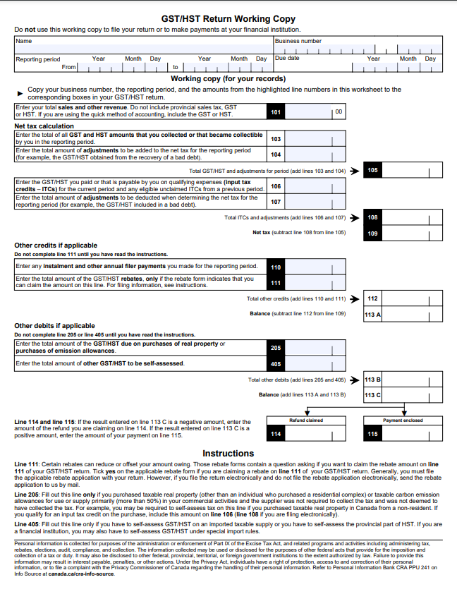
Remitting HST

Slide 12
Remitting HST – ITC’s
Information Required on Sales under $30
Information Required on Sales $30 to $149.99
Information Required on Sales $150 +
Supplier’s business or trading name or an intermediary’s
The invoice date or if no invoice issued, the date on which the GST/HST is paid or payable
The total amount paid or payable
All requirements for sales under $30
An indication of the total amount GST/HST charged
An indication of which items are taxed at the GST or HST rate
All requirements for Sales $30 to $149.99
The buyer’s name or trading name of the buyer’s authorized agent or representative
A brief description of the product or services
The terms of payment

Slide 13
Remitting HST – Special Considerations
Some ITCs also has special rules, usually correlating to the rules of the business expense they’re attached to.
ITCs can be claimed up to four years from when it could be first claimed for most businesses. Few exceptions are only two years.
If you’re an annual filer and your net HST for the previous fiscal year is $3,000 or more, you will need to make quarterly installments.
A nil remittance needs to be filed for each period that doesn’t have any sales or ITCs to report.

Slide 14
Paying Yourself from Your Business
Sole Proprietorships
Corporations
Simply transfer money from your business account to your personal account.
It’s called “Drawings” in your accounting books. Similarly, money you transfer into the business is called “Investment”
No effect on taxes owed/paid.
Paycheque
Taxed on individual return and is a business expense for the corporation.
Dividends
Taxed twice (Corporate and Individual tax) and can’t be paid out if the business has no retained earnings.
Shareholder Loan
Tax-Free, but requires a previous investment into the corporation or it must be paid back.

